Slide 1

Industrial project and training in HighRadius
Name : Kunal Kumar
Reg.No : 11901883

Slide 2

HighRadius is a product-based multinational company. Which was founded in 2006 by Sashi Narahari in USA.
Highradius is a product-based company that basically works in the field of machine learning, Artificial Intelligence, and Data analytics.
The annual transaction of HighRadius is near about $2.23 trillion.
Introduction

Slide 3
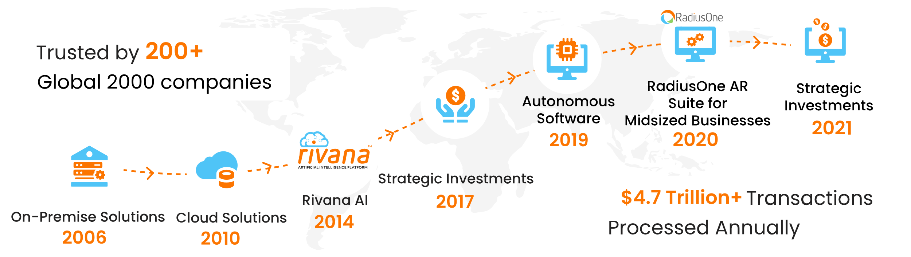
Annual Growth

Slide 4
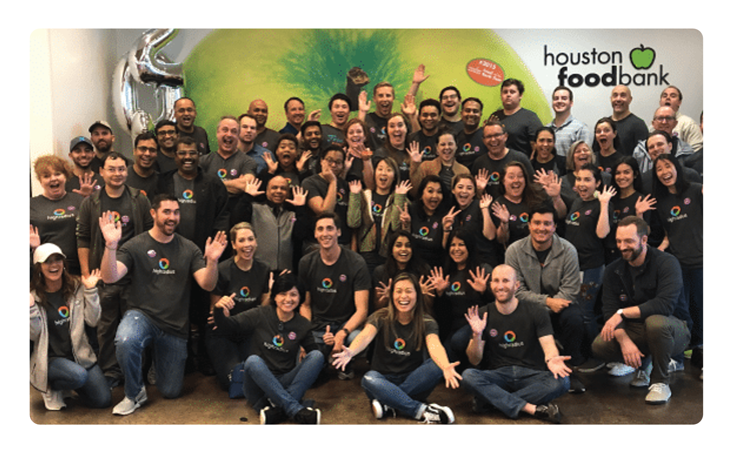
Work culture
The work culture of HighRadius is very good.
We work with fun and maintain a work-life balance.
We always look further to learn new technology.

Slide 5
B2B Invoice Management Application
This is a web application which is used to predict date of payment of a customer in which user can search, delete and update the data. According to that he can predict the date of payment and he can send a remainder to customer.
This project is divided in three parts
Machine Learning
Frontend devopment (ReactJs)
Backend (JavaServlt)

Slide 6
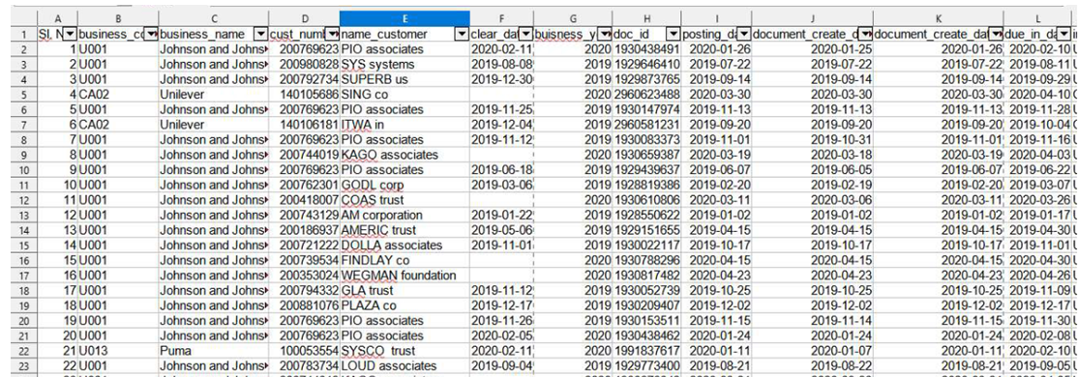
Funcionality
Data Loading in Database

Slide 7
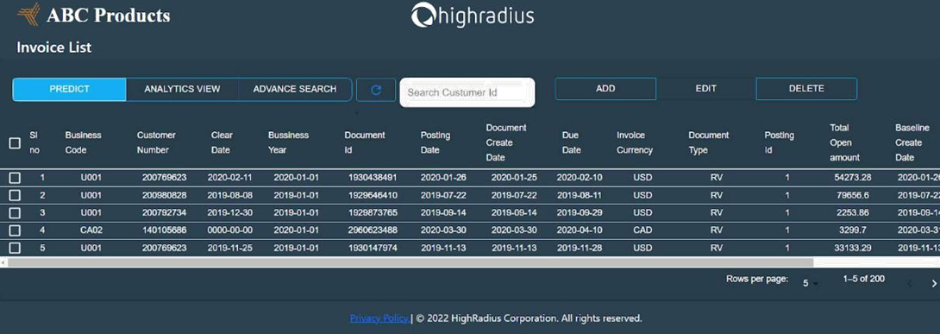
2. UI Representation of the Data

Slide 8
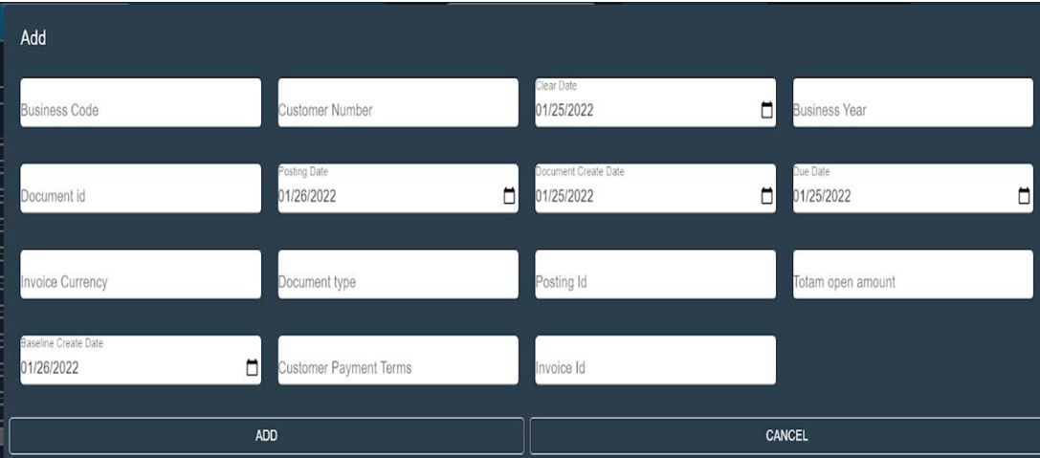
3. Add Button of UI

Slide 9
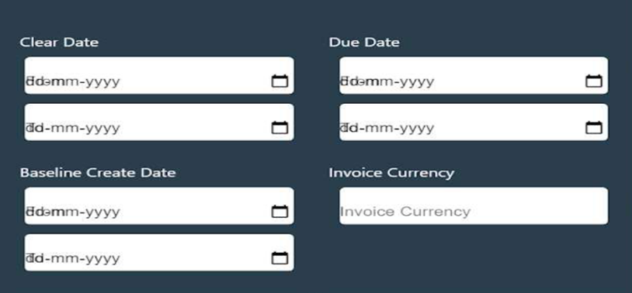

Slide 10

Back-End
Connecting Databasae
POJO class () Plain Old Java Object
Performing the CRUD operation

Slide 11
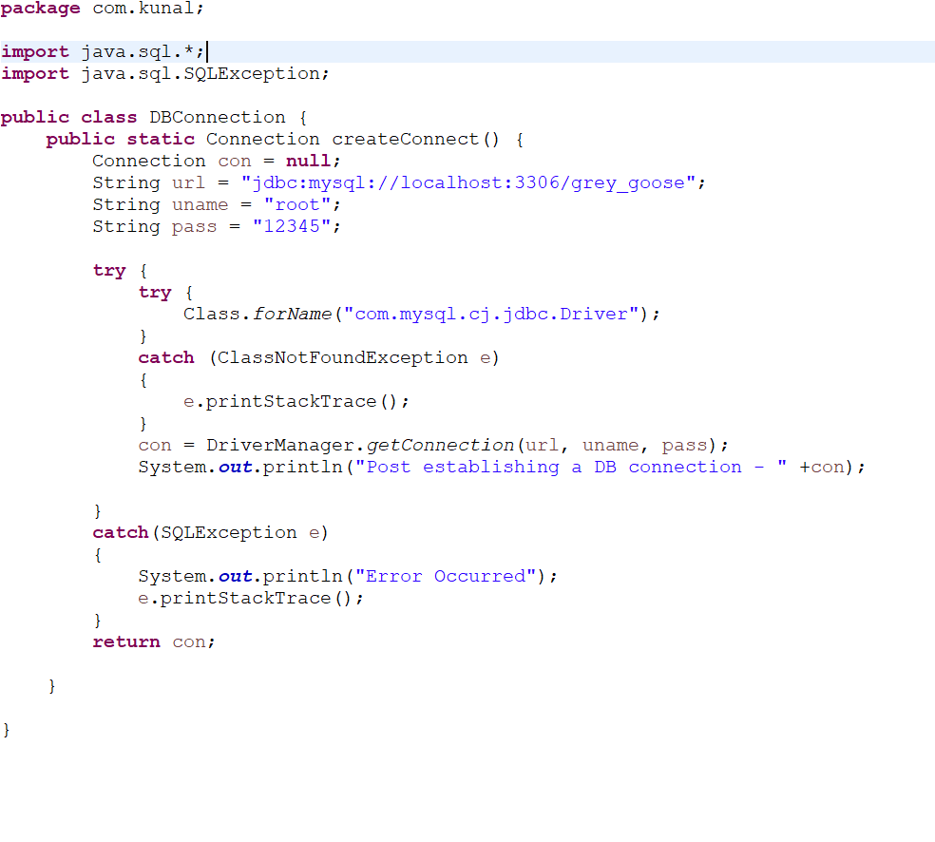

Connecting the Database

Slide 12
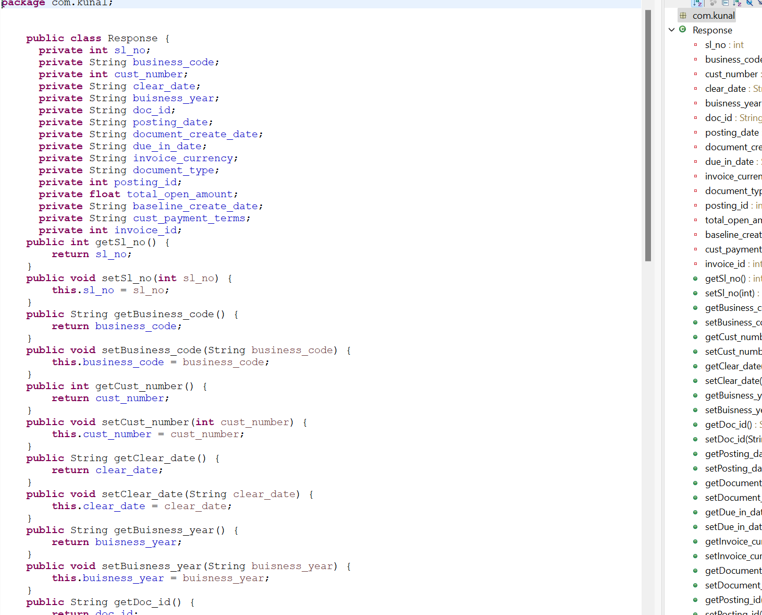

POJO Class

Slide 13
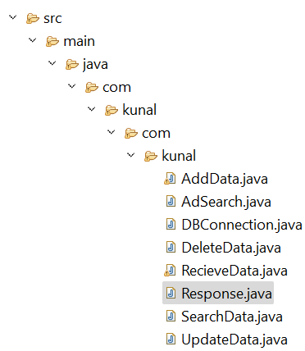

CRUD

Slide 14


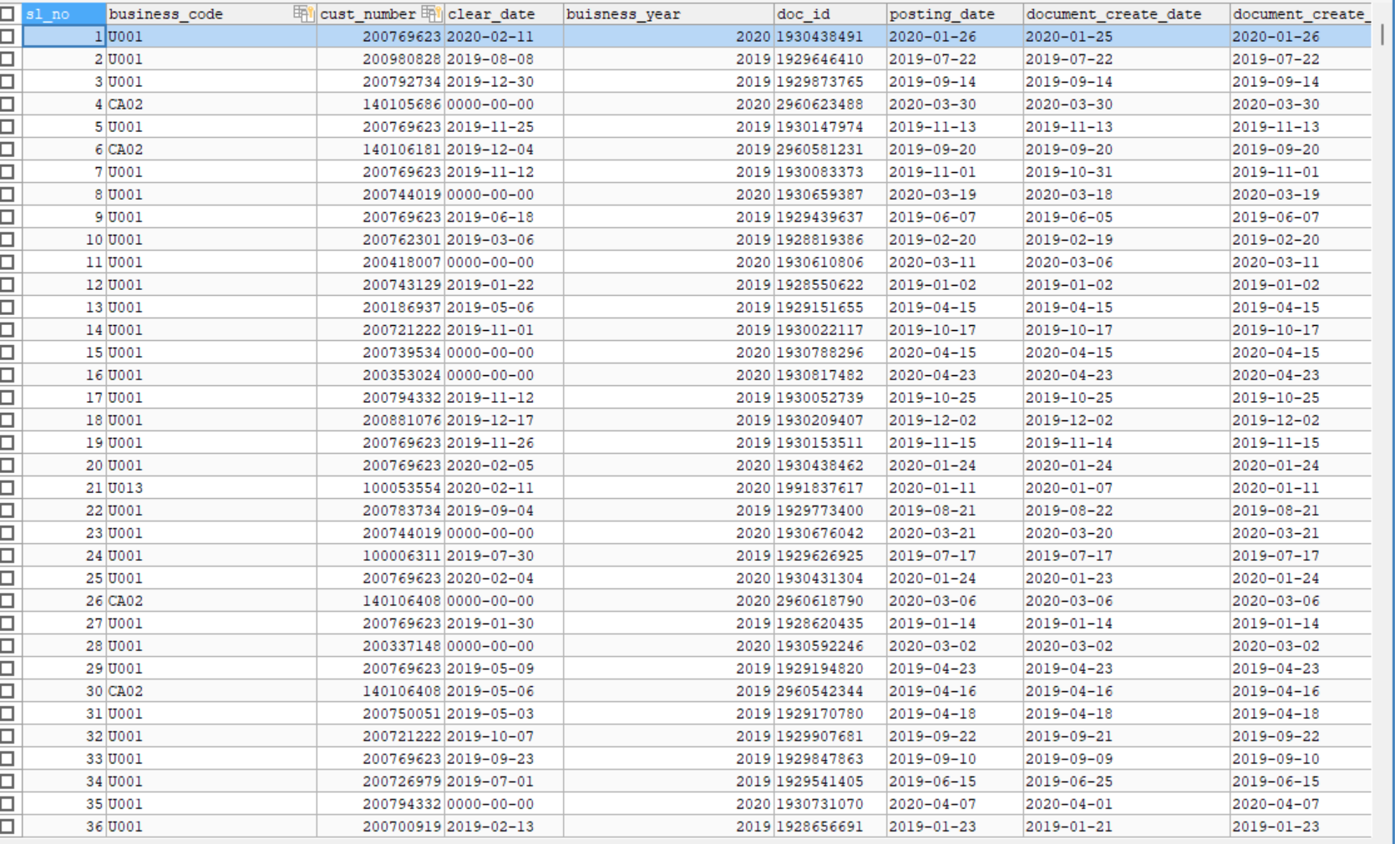
DATABSE and DBMS

Slide 15

Thank You

